Slide 1


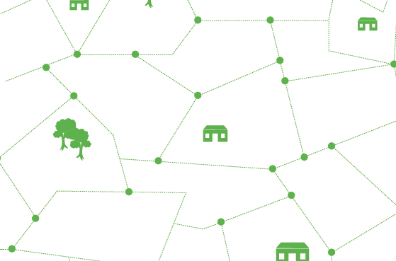
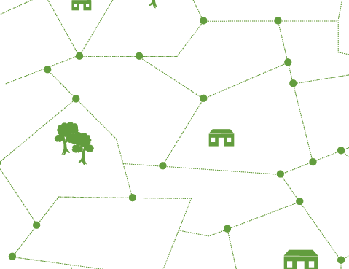
A
Presentation 10 December 2015
Santa Maria, Sal
(Foreign Property Rights Holders )

Slide 2
  What is the Cadastro Predial?
Unifies and harmonizes existing registries:
  municipal “matriz” (tax)
  “registro predial” (real estate legal ownership registry) of the Ministry of Justice, national government. Previously not required.
Combines spatial information (parcel borders) with Legal Rights Information
Registo Predial will become obligatory

Slide 3
What is Operação de Cadastro Predial?
Parcel by parcel, house by house, survey (started in Espargos, now also in Santa Maria)
Take physical measurements of ground parcel (N/A for a condo unit, for which only the “parcela mãe” is measures)
Collect ownership and related documents (including ID, NIF, marriage documents)
Secondary rights (concession, surface rights, etc.) as well as “Direito de Propriedade”

Slide 4






Official Notice of Start of OCP
Field Data Collection
CARACTERIZAÇÃO PROVISÓRIA
EXPOSIÇÃO E CONSULTA PÚBLICA
CARACTERIZAÇÃO DEFINITIVA
INJECÇÃO CADASTRO E REGISTO PREDIAL

Slide 5
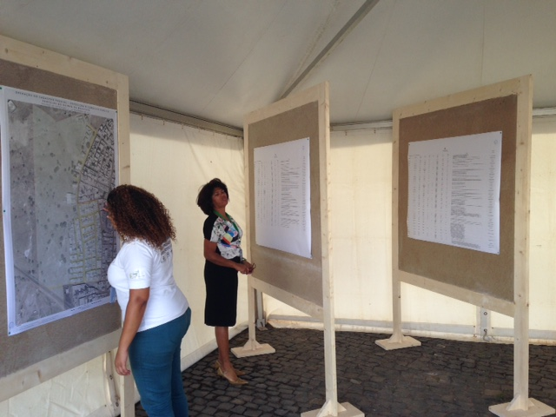
Consulta Pública
LISTA NOMES
(TITULARES)
LISTA PRÉDIOS (CARACTERIZAÇÃO)
MAPA
(PARCELAS / LOTES)
123
456
789
123
123
012
345
678

Slide 6
Marital Property Regimes
Cabo Verde law looks to apply the law of the nationalities of the couple. CC Art 52(1).
If the nationalities are the same, then marital law of that nation applies.
If the couple is of different nationalities, Cabo Verde law looks to the law of the domicile/residence of the couple. CC Art 52(2)
Not a critical fact where couple is married.
União de facto (non-married couples living together). Cabo Verde law will apply if couple are of different nationalities and they live in Cabo Verde

Slide 7
Scenarios – Marital Property
English citizens (married) living in Sal. Property acquired after marriage; documentations exists is in name of one of them. Presumption: not common property. Same for Americans (with few exceptions). If both citizens of the same civil law country (such as Spain, Italy) presumption would be the opposite.
Foreigner married to Cabo Verdian. Property regime will depend on their residence. If living in Sal/Cabo Verde, presumption will be common property. But if living in England, America: separate property (unless of course documents are already in both names).

Slide 8
Inheritance (Succession)
By will/testament
Intestate (no will)
Cabo Verde law refers succession/inheritance to the law of the nationality of the deceased (CC Art. 60)
The foreign law of the deceased’s nationality may refer the question back to Cabo Verde law (if, for example, that law defers to the physical location of the real property)..
Testament/Will may be executed in Cabo Verde

Slide 9
Scenarios – Inheritance
If deceased was married, then first apply marital property regime law to determine if any property held in the name of deceased actually belonged to the spouse prior to death of titleholder. Then apply inheritance rules.
For a foreign citizen who holds property in Sal, property may be subject to Cabo Verde inheritance law (including mandatory set-aside portion), depending on whether that nation’s law refers question back to Cabo Verde law. This could apply to both intestate succession, as well as cases where a will exists. (There may also be “Double Devolution” or “Double Renvoi” where substantive rule to be applied is referred back yet again to the rule of the foreign nation).

Slide 10
Reserved Portion of Estate
“Sucessao legitimária” – CC 2081 ss - Reserved portion of decedent’s estate that must be given to certain people (with some exceptions), even if there exists a will/testament:
  (a) if there are children: 50% of estate if there is one child or 2/3 of estate if there is 2 or more;
  (b) if no children, but spouse + ascendentes: 2/3 of estate;
  (c) if no children, and no ascendentes, then spouse’s reserved portion is 50%;
  (d) if no children, no spouse, but ascendentes: 50% if parents, or 1/3 if the ascendentes are further removed.

Slide 11
Intestate Succession (no will or testament) – Cabo Verde Law
Order of Succession (each level takes 100% of the available inheritance). CC 2016 ss
Descendents
Spouse (50%) e ascendentes (50%)
Siblings and their descendent
Outros colaterais até o 4º grau;
State

Slide 12

MORE INFORMATION
http:// cadastropredial.gov.cv
/cadastropredialcv
Linha verde Casa Cidadão: 8002008

